Slide 1
Employee Attrition Problem

Slide 2
Steps to deal with the problem
Data Collection
Data Analysis and Visualisation
Use Predictive Model to predict employee leaving
Take Necessary Steps

Slide 3
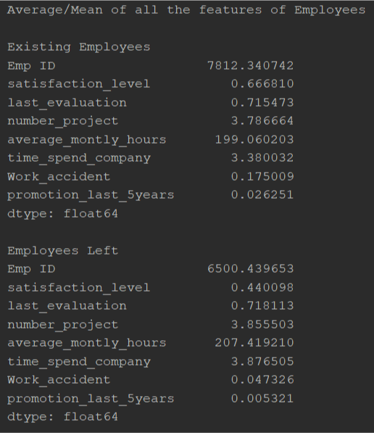
Data Analysis and Visualization
Using Statistics to analyse the data.
Finding the reasons/factors why employees are leaving.
Comparing the existing employee vs the employees who left.
Plotting graphs.

Slide 4
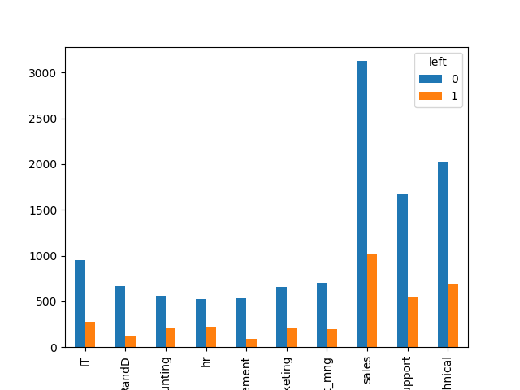
Bar Graph for different departments
By looking at this graph, we can see that sales, support, technical have highest number of employees leaving.
We can give special attention to these departments.
Employees in Different department

Slide 5
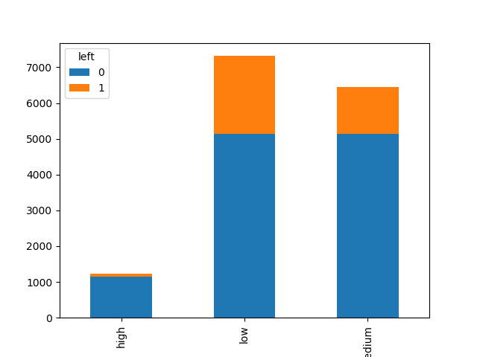
Bar graph showing employees leaving having different salaries
As seen from the graph mostly employees with low salary are leaving.
The employees with high salary have very less tendency to leave.
Employees with different salaries.
The blue ones are present employees while the orange ones are the one who have left.

Slide 6
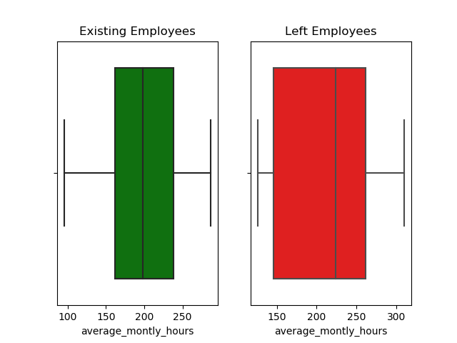
Box Plot for Average monthly working hours
It can be seen from the box plot that the average monthly hours for employees who have left is higher than those who are present.

Slide 7
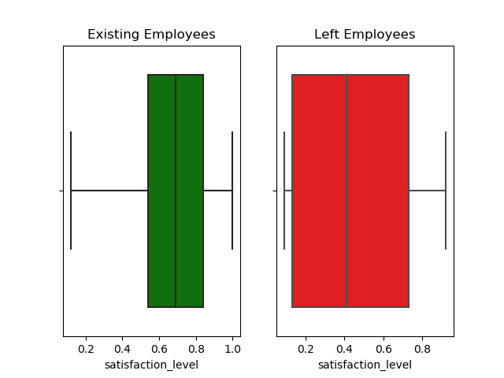
Box Plot for satisfaction level
It can be seen from the box plot graph and is also obvious that the average satisfaction level of present employees is higher than those of employees who have left.
Also the satisfaction level of employees who have left have higher variation than those who are currently present.

Slide 8
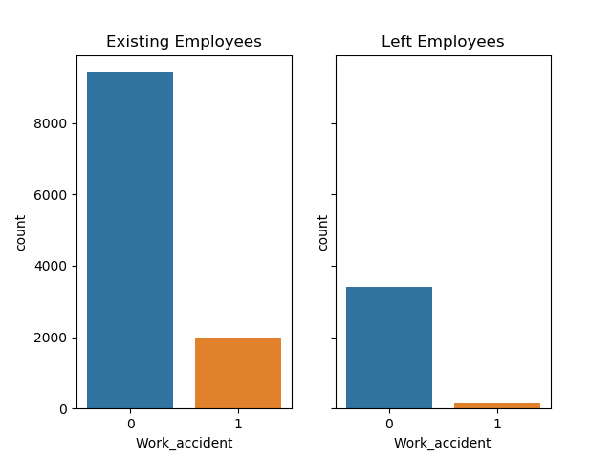
Count Plot for number of accident
The percentage of employees who have had an accident is higher in case of existing employees.

Slide 9
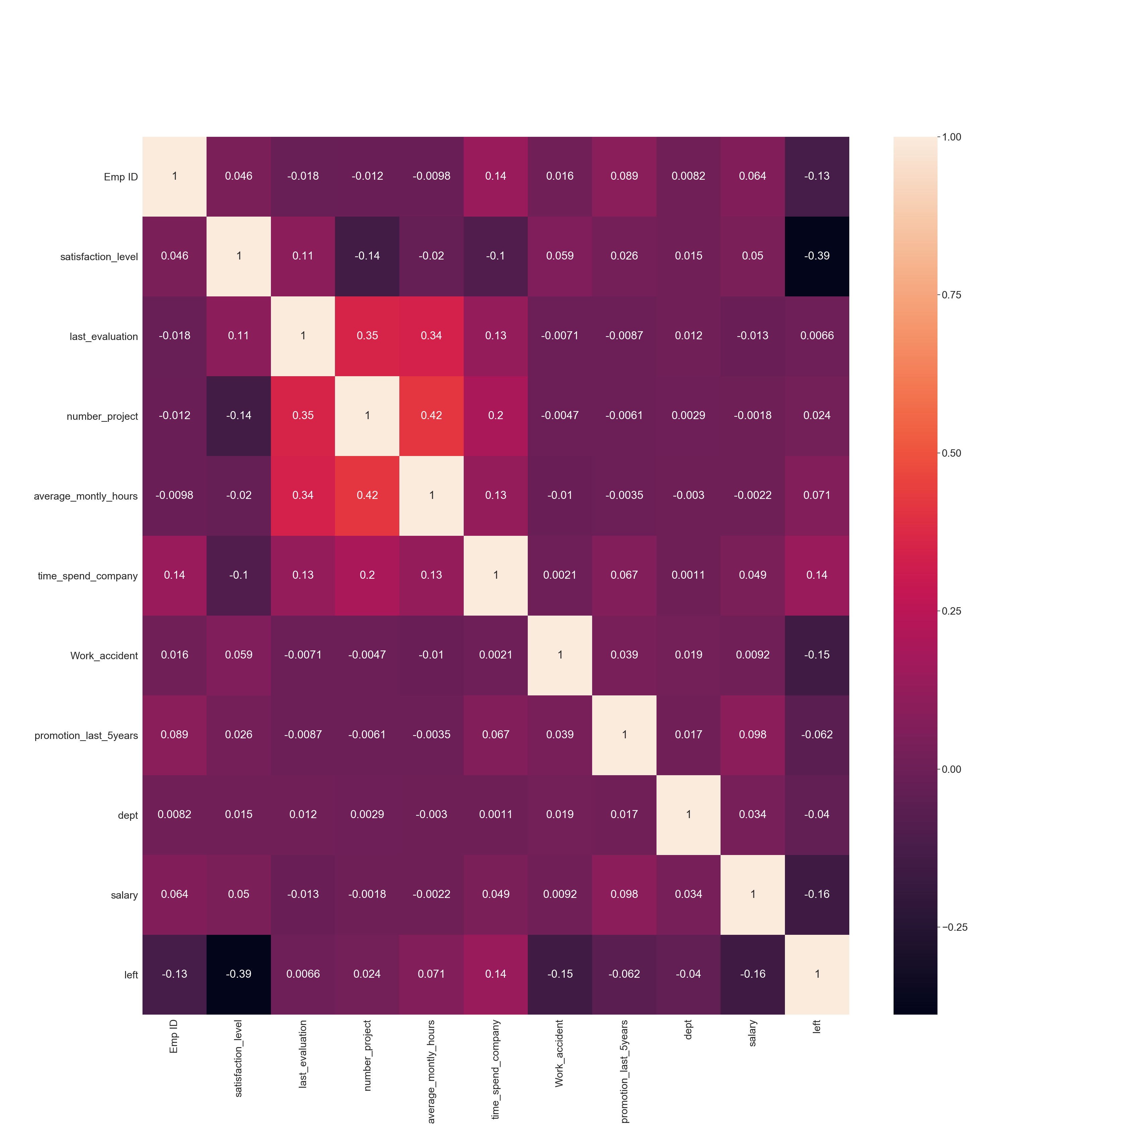
Correlation of Variables using Heatmap
From the heatmap we can say that average working hours and number of projects are highly correlated. We can remove one of them in our predictive model to improve prediction.
Also we can see that satisfaction level and chances of leaving are negatively related.

Slide 10
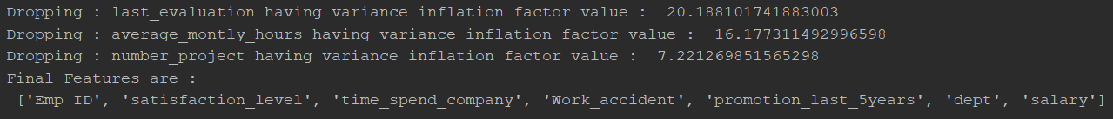
Filtering Data by removing collinearity, Normalizing, Scaling
Filter, normalize , scale the data appropriately.
Remove collinearity in the features set.

Slide 11
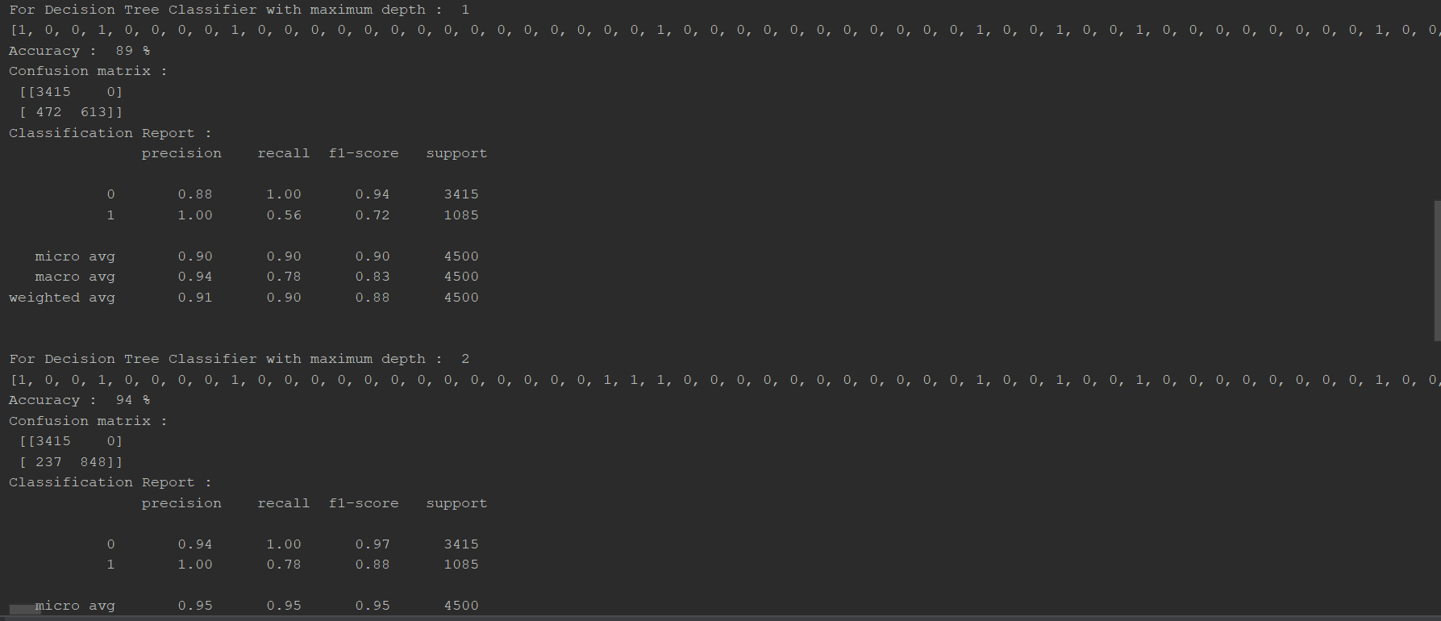
Prediction Mode
Decision Tree Classifier is used with maximum depth starting from 1 to 5.
Decision Tree Classifier doesn’t require feature scaling.
‘Gini’ was used as criterion for choosing the next feature/attribute.

